Slide 1

Metropolitan College
Project:
Type II Diabetes Management Web-Based Application
A Teaching tool for the BU Health Informatics Course
Iteration #1 – 10/17/2013
CS673 Software Engineering
Fall 2013

Slide 2
Architecture
View
Controller
Model
Users
index
add
edit
view
usersController
index()
add()
edit()
view()
users
patients
- diagnoses
- drug_allergies
- visits
- medhistory_complaints
- vitals_labs
- treatments
- treatment_medicines
medicines
Patients
search
add
edit
view
patientsController
search()
add()
edit()
view()
delete()
Visits
index
add
view
search
algorithm
plot
visitsController
index()
add()
view()
algorithm()
plot()

Slide 3
Implementation
MVC architecture with cakePHP
Framework organizes design into sections
Easier for multiple developers
Input validation on server side
Easier database access
Bootstrap V3.0
Used for Styling & Menu
Provides Responsive Layout for Browser Resizing and Mobile Usability

Slide 4
Project Management - Metrics
Total Lines of Code: 2596
Model: 359
View: 1381
Controller: 387
Database: 176
Algorithm: 293

Slide 5
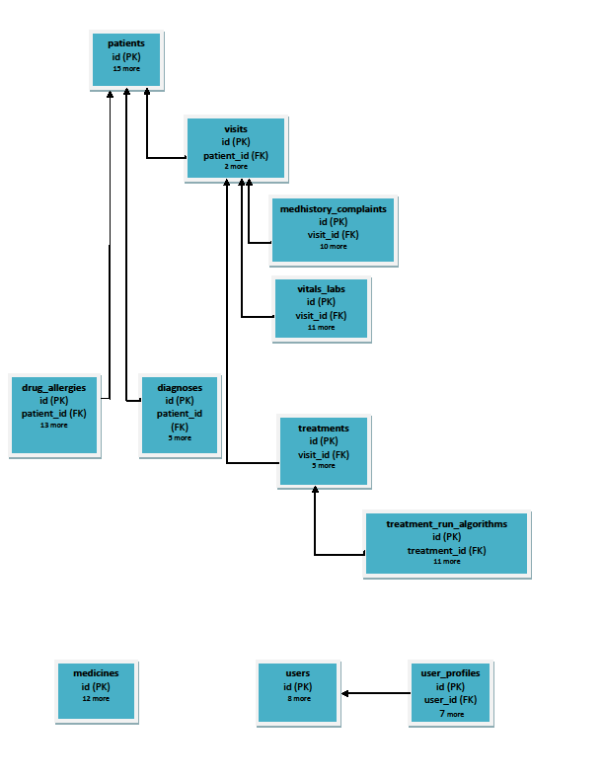
Database Schema

Slide 6
Testing
Model, View, Controller - Integration Tests
Main page
Patient Management: search, add, view, update
User Management – needs minor changes
Database
Unit tests
Integration tests – same as model
Algorithm – Unit Tests
Most test cases complete including drug allergies
Need to add contraindications (adverse events)

Slide 7
Some Algorithm Test Cases
Test Conditions | Results
A1c = 4 Allergies = none | Algorithm decision: Warning: Patient is Hypoglycemic Therapy: none Medicine1 = none Medicine2 = none Medicine3 = none
A1c = 6.6 Allergies = Metformin | Algorithm decision: Start or continue with mono therapy. Therapy: Lifestyle + Monotherapy Medicine1 = GLP-1RA Medicine2 = none Medicine3 = none
A1c = 7.6 Allergies = none | Algorithm decision: Starting with dual therapy. Therapy: Lifestyle + Dual Therapy Medicine1 = Metformin Medicine2 = GLP-1RA Medicine3 = none
A1c = 9.1 Allergies = none | Algorithm decision: Start with triple therapy. Therapy: Lifestyle + Triple Therapy Medicine1 = Metformin Medicine2 = GLP-1RA Medicine3 = TZD

Slide 8
User Stories for Iteration # 1
Completed
Main Page
Search Patient
Add Patient
View Patient
Update Patient
Delete Patient
Not Complete
Input validation & date selector
User Login & Register New User – needs minor updates

Slide 9
Progress & Lessons Learned
Progress
All stories completed except User management
Started on 2nd iteration stories
Most of algorithm tested to minimize risk
Most of database tested to minimize risk
Lessons Learned
cakePHP has a learning curve
Testing needs more time so start early
Communications with large group is a challenge

Slide 10
Future Work
User Stories
Add Visit - started
View Visit - started
Run Algorithm - started
Plot patient data
Add/Update medication table
Calculators
After this Project
Implement more diabetes management algorithms

Slide 11
Thank you!

